Slide 1
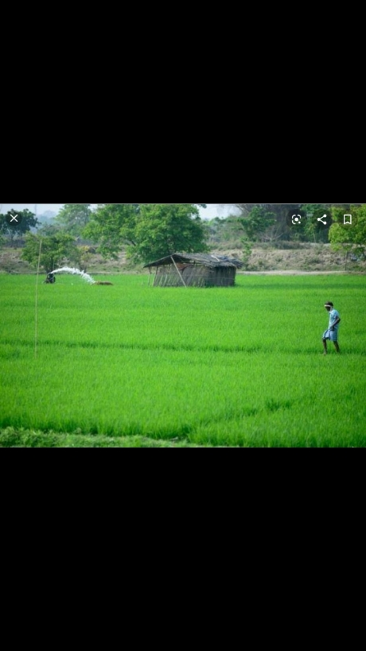
CROP PRODUCTION
Agriculture
Crops
Green revolution
Kinds based on reasons they are grown
Kinds based on the seasons they grow
Stages of agriculture
Nitrogen cycle
Food from animals

Slide 2
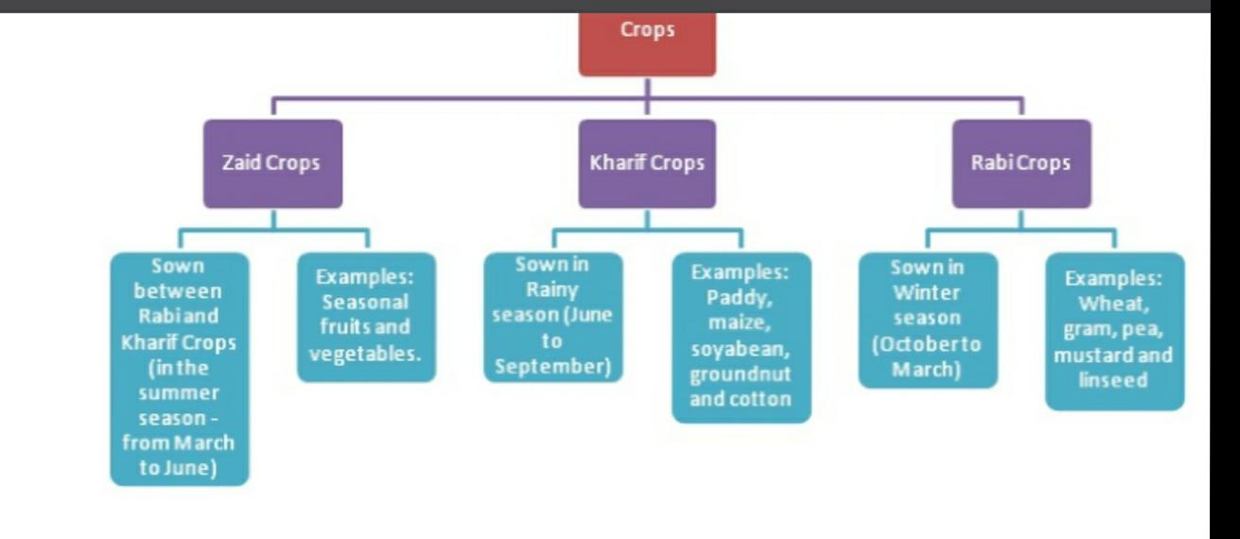

Slide 3
BASIC PRACTICES OF CROP PRODUCTION
Seven agricultural practices followed while growing a crop are:
Preparation of Soil: To loosen and turn the soil.
Sowing: Planting of seeds of a crop in soil.
Adding Manure and Fertilisers: Adding essential nutrients to soil for growth and development of plants.
Irrigation: Supplying water to plants at regular intervals.
Protection from Weeds: Removal of unwanted plants from the cultivated field to allow crops proper access to lights, space, and nutrients.
Harvesting: Cutting mature crops from fields.
Storage: Keeping grains or produce safe from rats, insects, microorganisms and moisture.

Slide 4
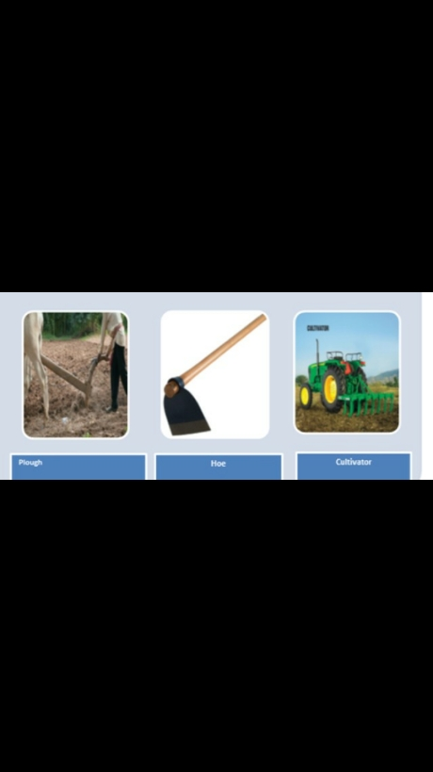
Preparation of Soil
Why do we loosen or turn the soil?
Loosening the soil is important because it:
allows the toots to go deeper into the soil and yet, breathe easily (allowing air to reach the roots),
helps in growth of microbes and earthworms that add humus to the soil and turn and loosen the soil further, and
nutrient-rich soil comes to the top and can be used by plants.
The process used to loosen and turn the soil is called Tilling or Ploughing. After tilling, Levelling is donein which the big clumps of soil called crumbs are broken (and levelled). Levelling the field helps in the process of sowing and irrigation.

Slide 5
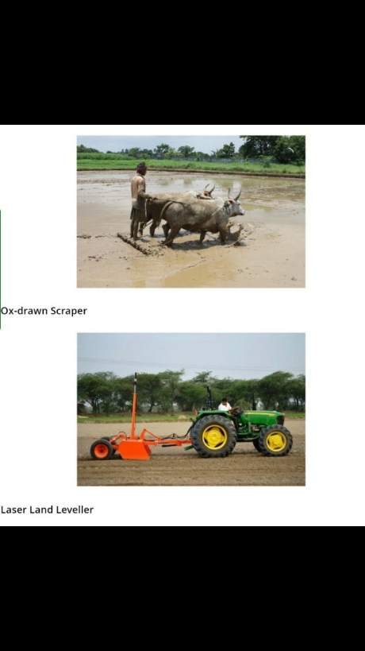
Levelling
Land levelling is typically done in mildly sloping lands where farmers use surface irrigation methods such as furrows, borders, basins or floods. It ensures uniform distribution of irrigation water in the root zone of the crop. It also helps in seeding and managing the crop better, which means that the yield and quality of the crop is better.

Slide 6
SOWING
Farmers should use good-quality seeds that are clean, healthy and give high yield. Selection of the right variety of seeds depends on the soil, climate, irrigation method, and other regional factors.
The Ministry of Agriculture in India has set up a national-level organisation called the National Seeds Corporation (NSCC) that tests the quality of seeds. State Seeds Corporations and Agricultural Universities have also set up seed testing laboratories throughout India. These labs test seeds for their:

Slide 7
Precautions to be taken while sowing
While sowing seeds, it is essential to make sure that:
Seeds are healthy and of high quality.
They are planted at correct distance from each other so that they can get proper light, water and nutrients from soil.
They must be sown deep enough to protect them from animals and birds (which might eat them) and wind (which might blow them away) but not so deep that they may not get enough air to germinate.

Slide 8
Why it is better to sow seeds uniformly?
Seeds should be planted at appropriate distance to avoid overcrowding of plants. It allows plants to get proper sunlight as well as sufficient water and nutrients from the soil.
Why are plants kept in small bags in nursery?
Few plants (like paddy, forest plants, and flowering plants) are first grown in a nursery into seedlings and then, transplanted to plants manually. Keeping the seedlings in bags makes it easier to transfer them to another place.

Slide 9
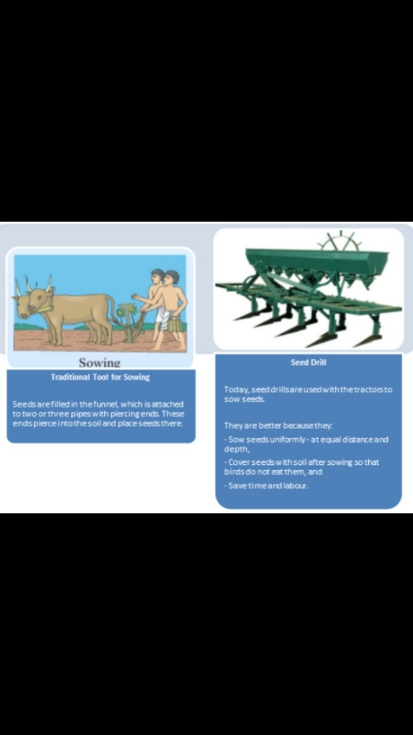
Tools used for sowing

Slide 10
Adding Manure and Fertilisers
Why are manure and fertilisers added to the soil?
When crop after crop is grown in the same field, the soil becomes poor in certain nutrients. Manure and fertilisers are added to the soil to replenish it with nutrients to ensure healthy growth of plants.

Slide 11
What are different types of manure that farmers can use?
Manure can be of various types, such as:
Natural Organic Manure: This includes raw manure, compost, and green manure:
Raw manure is a mixture of cattle and domestic waste.
Compost is well-rotted plant and animal residue.
Green Manure are crops grown in the field as the pure crop or as an intercrop between the main crops – and then, buried in the field to enrich the soil.
Biofertilizers: These are the nitrogen-fixing organisms that are widely used in organic farming and make agriculture sustainable. These include Rhizobium, Azotobacter, blue-green algae, and Mycorrizae (a type of fungi that increases phosphorus uptake in fruit crops like papaya and citrus fruits).
Vermi-Compost: It is a type of compost which is made using earthworms.

Slide 12
What are the three methods of replenishing the soil with nutrients?
The three methods of replenishing the soil are:
Adding organic manure to the soil,
Adding chemical fertilizers to the soil,
Leaving the field uncultivated (or fallow) between two crops, and
Crop rotation, in which different crops are grown alternately to allow the soil to replenish with different nutrients.

Slide 13
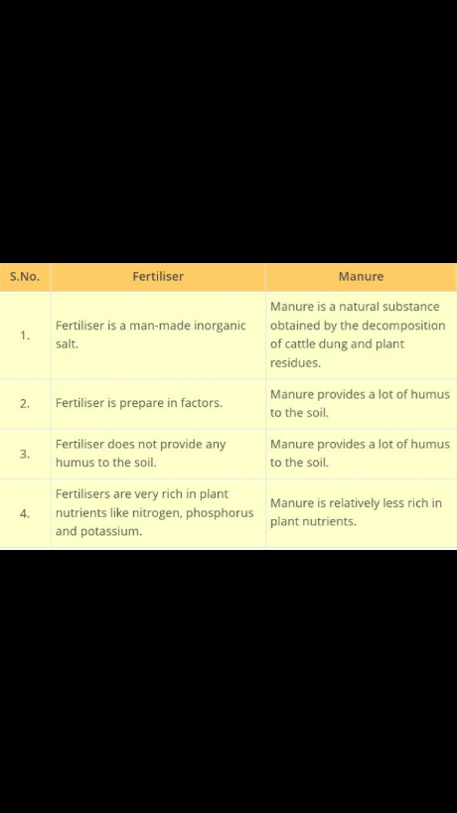

Slide 14
Pros and Cons of using Fertilisers
Pros: They are chemicals, rich in particular nutrients and help farmers get better yield of crops like wheat, paddy and maize. Cons: They make soil less fertile and also cause water pollution.
Why is Manure better than Fertilisers?
Organic Manure is better than Fertilisers because:
It adds humus to the soil and increases its water holding capacity,
Improves soil texture,
Makes soil porous which makes exchange of gases easier, and
Increases the number of friendly microbes

Slide 15
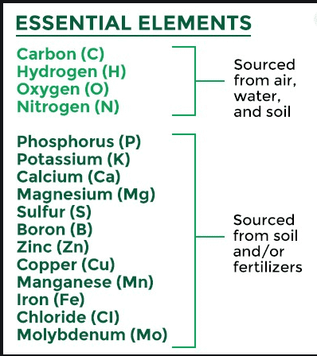

Slide 16
Manures and fertilizers
https://www.youtube.com/watch?v=TjbxOEEOCh0

